Slide 1


Excellence is made together
CUSTOMY – The customer data platform to connect potentials and profits

Slide 2


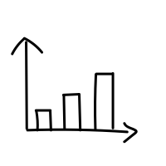



Thank you for your interest in the analytics union!
Here you will find an overview of our solutions for sustainable new customer acquisition and effective existing customer management.

Slide 3

Customer Acquisition
We help you reach your ideal target group through advanced deepRFM customer base analysis – identifying the most valuable multibuyers within your industry among typical mail-order customers.
With our data-driven approach, we ensure precise audience selection based on real transaction and purchasing behavior. You only receive high-quality addresses of proven mail-order buyers with strong activity levels – the perfect foundation for your catalogs and direct mail campaigns.
Prospecting
ReUse
QuickUse
First-time use of addresses
Repeated use of delivered addresses
Repeated use of delivered addresses
Use of the provided addresses within 90 days after data delivery
Further use of delivered addresses is permitted within 90 days.
Use within 90 days after data delivery and within 12 days after PAL

Slide 4
Optimized Existing Customer Selection
Actively shaping customer relationships offers numerous opportunities to increase revenue and enhance customer lifetime value.
Companies that invest in optimized existing customer management benefit in the long term from a stable, loyal customer base and a sustainable competitive advantage.
Analytics Union offers three effective services for this optimization:
Optimization
ReNew
ReActivation
Qualify your customers to increase marketing efficiency
Qualification of inactive existing customers without a recent purchase date
Reactivation of own address databases

Slide 5
Optimization
Qualify your customers to increase marketing efficiency
Up to 80% increase in sales!
We combine your internal customer information (RFM) with your customers' transaction-based purchasing behavior in analytics union.
The result is a data set optimized through qualification, which enables you to save costs or increase response and sales when addressing your existing customers, depending on your objectives, thereby effectively increasing your marketing efficiency.
Sustainable existing customer management
Qualification of your existing customer base based on current purchasing behavior in mail order
Optimized approach
Efficient use of resources, resulting in cost savings and profit optimization
Effectively increase marketing efficiency through increased response

Slide 6

ReNew
Qualification of inactive existing customers without a recent purchase date
Qualification of inactive existing customers without a recent purchase date
Efficient and legally compliant approach to existing customers who have not made a purchase from your company for some time.
100% quality: data from active multiple buyers in mail order
100% security: data offered includes proof of origin
Through current scoring and delivery, including transparency printing, you can obtain and increase the value of your existing customers who are likely to make a purchase from your company.
Efficient and legally compliant communication with existing customers who have not made a purchase from your company for a long time
Delivery includes transparency print
Reactivation of customers thought to be lost
Increase in the customer lifetime value of your existing customers

Slide 7
ReActivation
Reactivation of own address databases
Recovery of inactive customers and prospects
We identify which of your inactive customers are currently active as repeat buyers in mail order and thus support you in reactivating customers you thought you had lost.
We also help you optimize the conversion of prospects into customers. Targeted mailings increase the proportion of sustainable responders.
Sustainable existing customer management
Reactivation of customers thought to be lost
Optimized conversion of prospects to customers
Efficient use of resources, resulting in cost savings and profit optimization

Slide 8

CUSTOMY Insights
Overview redefined
Optimize your campaign planning
Boost your success with CUSTOMY Insights, the practical value-added tool for developing your customer base and your products!
Overview redefinedNo question about it, no one knows your company as well as you do: the most important key figures, your best customers, the bestsellers among your products. CUSTOMY Insights organizes an overview of this valuable information and combines it with other important key figures from the entire mail order industry and your market environment.
Unique and valuable insights into your target customers’ buying behavior​ Key metrics to support campaign planning​ Clear internal benchmarking of your customer and product data​ Customer development in comparison to market trends​ Actionable insights into data quality​

Slide 9

Germany
Art | Produkt | Erläuterung | Preis TKP in €
Including source of origin for transparency print | analytics union Prospecting | Single use of addresses for new ​customer acquisition​​ (within 90 days after data delivery) | 140
 | analytics union ReNew | Qualification of inactive existing customers without a current last purchase date | 130
 | analytics union ReUse | Multiple use of supplied addresses for ​new customer acquisition​​ (any further use and any offer within 90 days) | 110
 | analytics union QuickUse | Amplifier for the same offer, within 90 days after data delivery and within 12 ​days after previous postal delivery​ | 65
Without source of origin | analytics union Optimization | Qualification of own customers to increase marketing efficiency | 110
 | analytics union ReActivation | Qualification of inactive existing customers | 90
All prices are subject to VAT.

Slide 10
Austria
Country | Product | Explanation | Price CPT in €
Including source of origin for transparency print | analytics union Prospecting | Single use of addresses for new ​customer acquisition​​ (within 90 days after data delivery) | 170
 | analytics union ReUse | Multiple use of supplied addresses for new customer acquisition​​ (any further use and any offer within 90 days) | 130
 | analytics union QuickUse | Amplifier for the same offer, within 90 days after data delivery and within 12 ​days after previous postal delivery​ | 80
Without source of origin | analytics union ReActivation | Qualification of inactive existing customers | 90
All prices are subject to VAT.

Slide 11
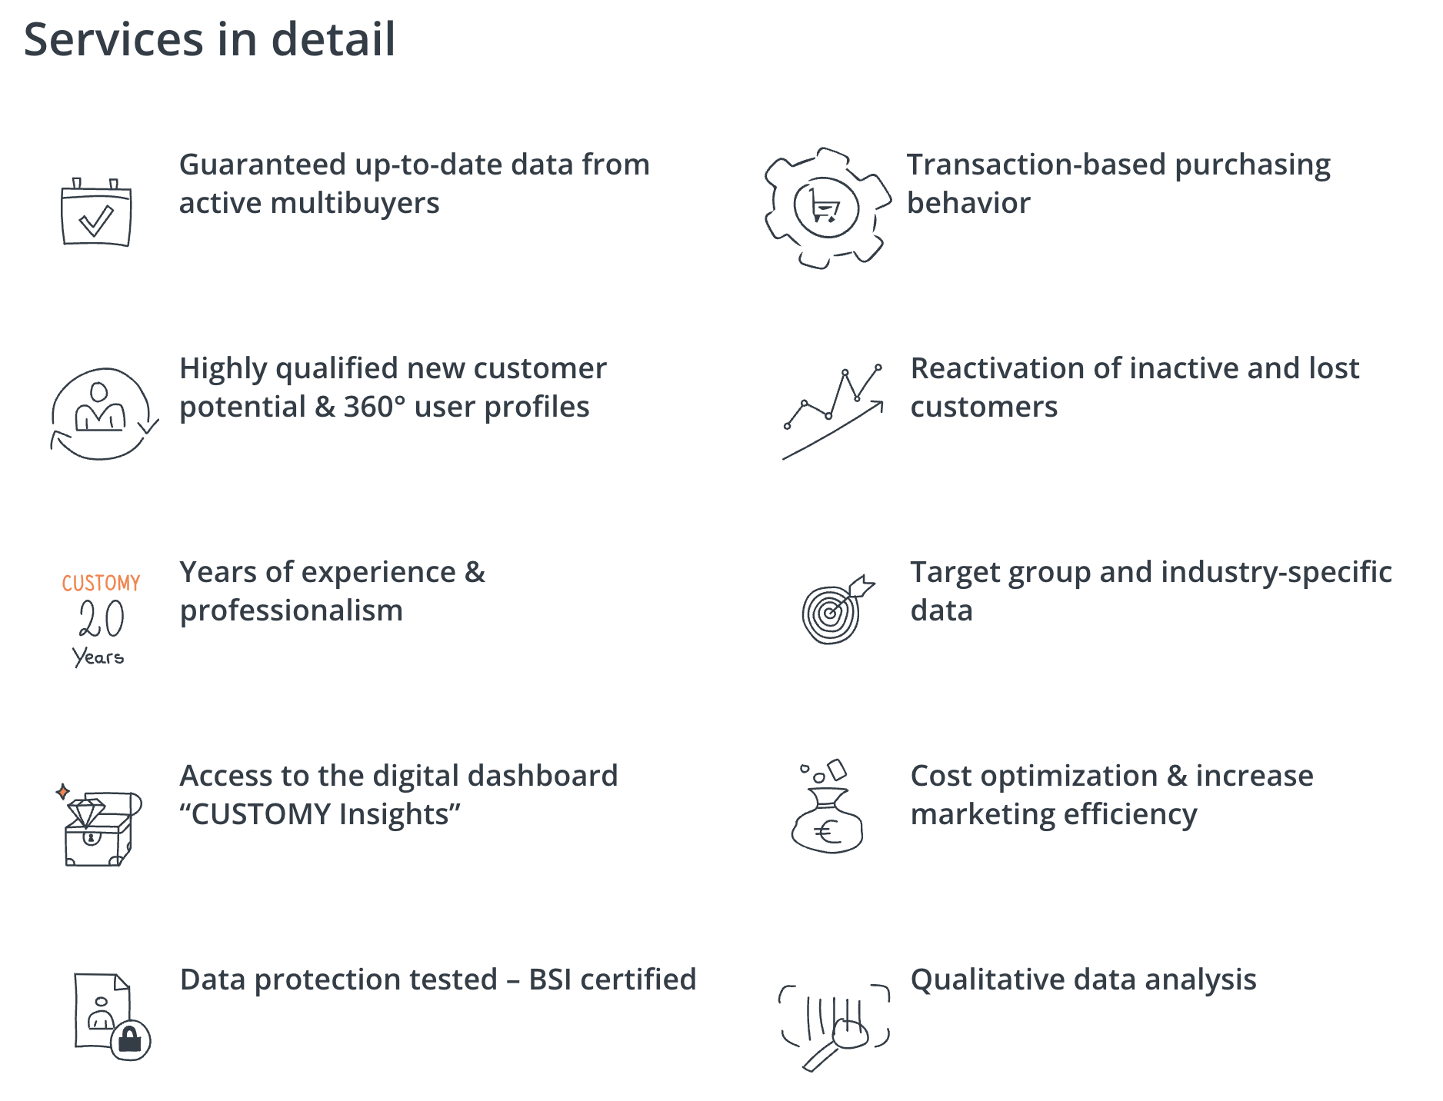
Services in detail

Slide 12

analytics union coop lovers
Free & transparent services!
No admission fees or other set-up costs
No basic or participation fees
No flat-rate, ancillary or hidden IT costs
No costs for standardized customer analysis
No long notice periods
We firmly believe in successful cooperation.
Up-to-date: Everything is based on the latest data
Equality: Equal rights and obligations for all participants
Overlap-free new customer potential
Multiple buyers: Focus on multibuyers
Discretion: Confidential participation
Protection: Optional exclusion of competitors a.G.

Slide 13
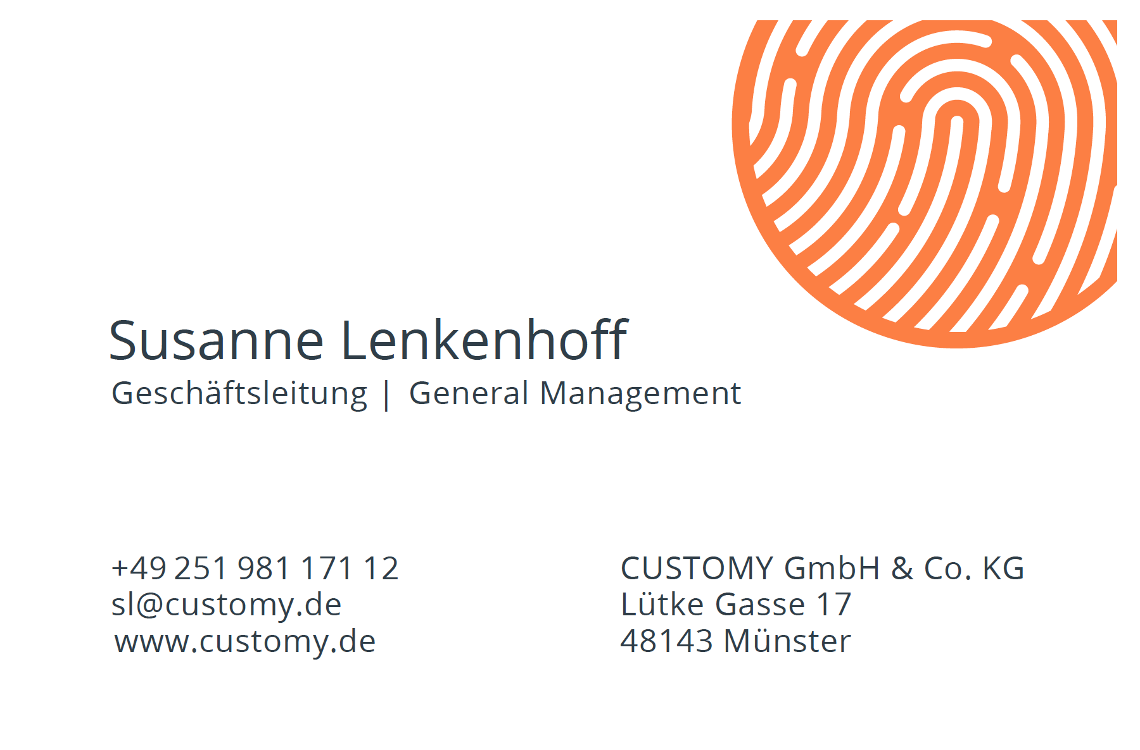
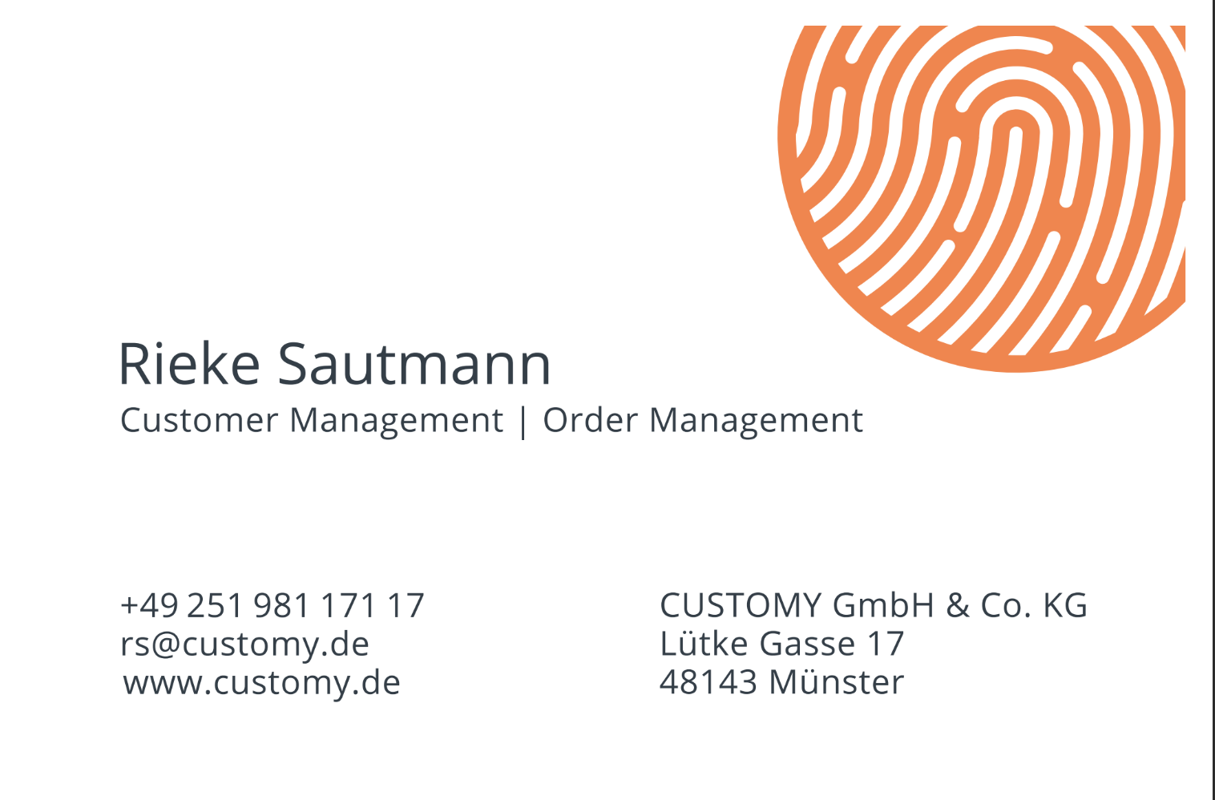
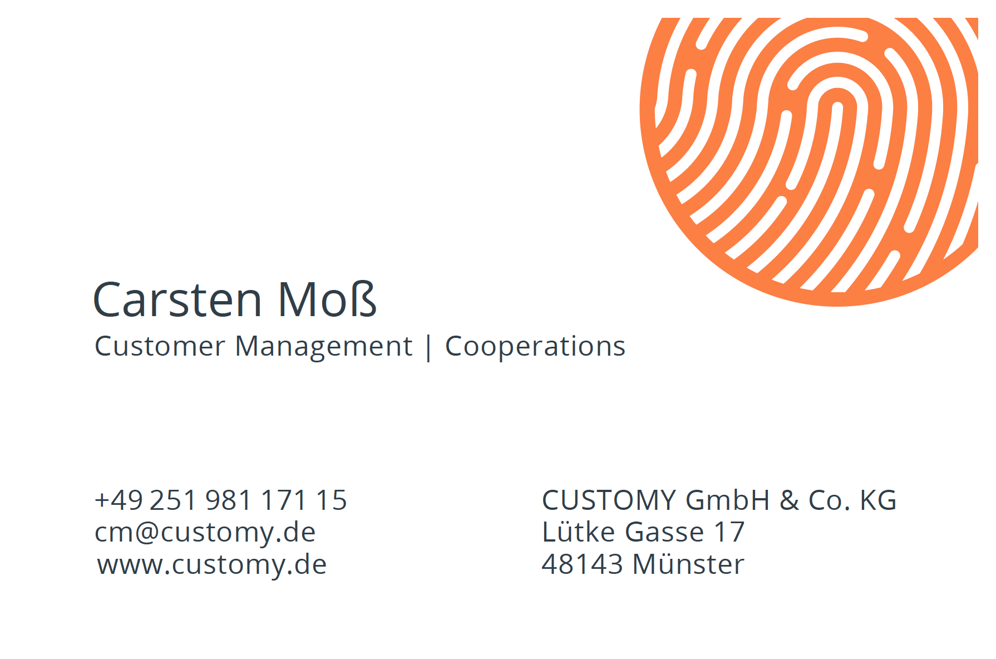
Your contact partners

